Slide 1
Mechanical Design
The Process
… continuation
Prof. J. Schiffmann

Slide 2
The Process
Phases of design process(Pahl & Beitz)
Customer Specification
1. Problem Definition
Specification
2. Conceptual Design
Concept
3. Embodiment
Preliminary Layout
4. Detail Design
Definitive Layout
Feasible Concept
5. Communication

Slide 3
Conceptual Design
Conceptual design
Customer Specification
1. Problem Definition
2. Conceptual Design
Establish selection of working principles to satisfy functions
Define & evaluate several concepts (combination of working principles)
Concept selection
3. Embodiment
4. Detail Design
Feasible Concept
5. Communication

Slide 4
Conceptual Design
Objective of conceptual design is one or more promising concepts (sketch level) that should be able to fulfil revised specifications
The conceptual design is a combination of working principles and explains how these interact with each other
Selected activities include
  Search for working principles, combination of working principles into operational structures, evaluation and selection of combinations

Slide 5
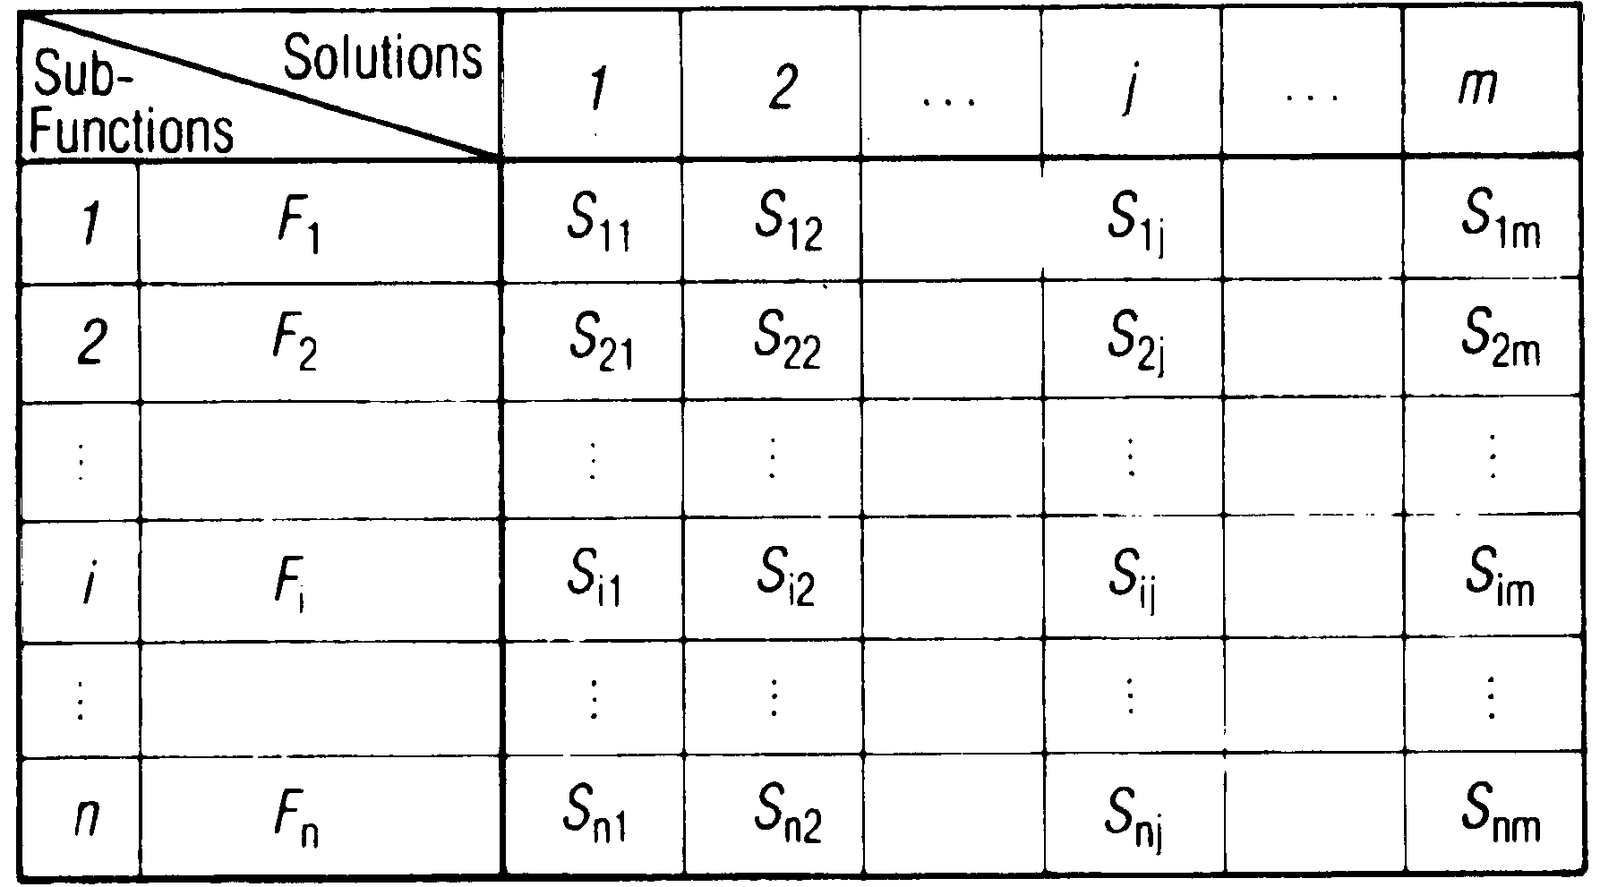
Morphological Matrix I
How to establish morphological matrix?
  List all functions of same level in one column
  List ideas and working principles how to implement each function

Slide 6
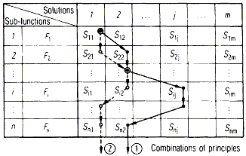
Morphological Matrix II
Morphological matrix contains complete solution space
  Gives indication with regards to solution space size
  Identifies all alternatives
  Visualization tool
Identify viable concepts
by selecting one solution
per function

Slide 7
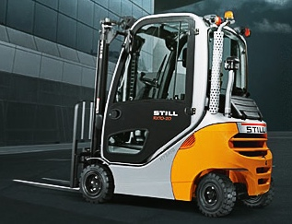
Example: Forklift I
Functions
  Propel system
  Store energy
  Transform into mechanical power
  Transmit power
  Change direction of system
  Stop system
  Lift load
www.still.ch

Slide 8
Example: Forklift II
Morphological matrix
  Matrix concentrates 23’040 combinations of concepts

Slide 9
How to Find Working Principles?
Profit from already existing solutions / concepts
  Analysis of competition → reverse engineering
  In which other application could a similar working principle have been implemented?
  Literature / Patents
  Project log book
Encourage creativity
  Brainstorming
    Collect ideas without evaluating them instantaneously
    Group discussion

Slide 10
Evaluate & Select I
Evaluate different solutions with regards to their performance
  List constraints and specified objectives
  Associate non-dimensional metric to performance level
  Add points for each concept and select best one
  A concept that cannot satisfy a constraint is not viable
  → Keep an eye on the main objective: client satisfaction!

Slide 11
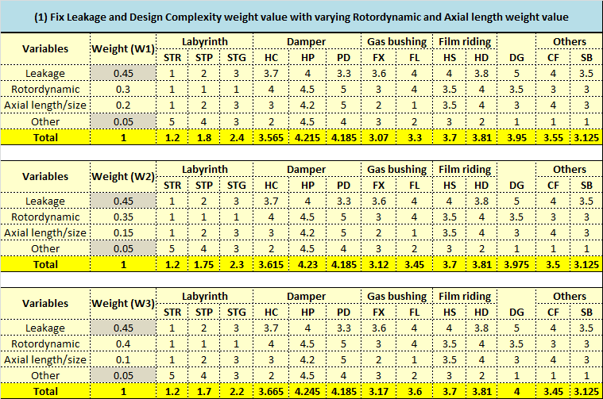
Evaluate & Select II
Check selection robustness by weight variation → Pugh tables

Slide 12
Evaluate & Select III
Tips and tricks
  Identify and select “coherent” working principles
  Avoid using broad evaluation metrics
  Play on criteria weights and test selection robustness
  Involve customer in concept selection

Slide 13
Conceptual Design
Conceptual design outcome
Customer Specification
1. Problem Definition
2. Conceptual Design
Promising Concept(s)
3. Embodiment
4. Detail Design
Feasible Concept
5. Communication

Slide 14
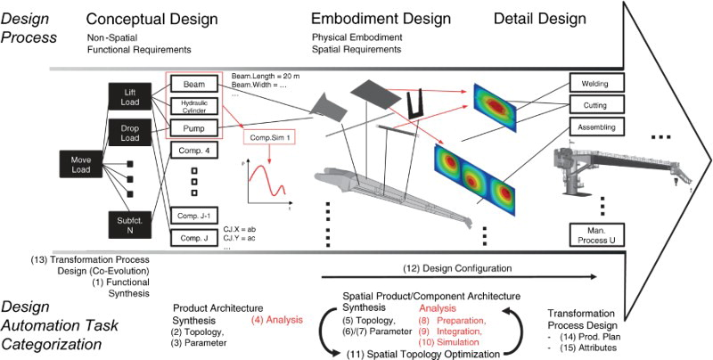
The Process
The design process undergoes various steps
Rigger et al., “Task categorisation for identification of design automation opportunities”, Journal of Engineering Design, Vol. 29(3), 2018

Slide 15
The Process: Embodiment
Embodiment
Customer Specification
1. Problem Definition
2. Conceptual Design
3. Embodiment
Simulation & analysis of selected concept(s)
Static, kinematic and dynamic sizing
Build CAD model of concept
Concept refinement
Eliminate weak spots
4. Detail Design
Feasible Concept
5. Communication

Slide 16
Embodiment
Flesh out selected concept(s)
  Size and arrange different elements of individual solutions
  Produce scale drawings/representation
All functions need to be implemented and represented
  Team should be able to explain and visualize the full system operation
  Keep an eye on constraints, specifications and customer satisfaction!
  Identify weaknesses and eliminate
  Risk analysis!

Slide 17
Simulation & Analysis I
Mathematical model allows to characterize operation of concept
  Is concept able to fulfill specifications while operating within constraints?
  How is concept performing?
Models are a support for the concept sizing
  Allows to perform sensitivity analysis
  Identifies operation range
Allows to avoid surprises when commissioning
  Avoids unnecessary cost and is a net gain of time

Slide 18
Simulation & Analysis II
Some tips
  Use Matlab or Simulink
  Think about objectives you would like to achieve with modeling before implementing models
  Which physical phenomena are significant and which phenomena do you want to analyze?
  Allocate sufficient time for modeling
  Use model to understand behavior of concept

Slide 19

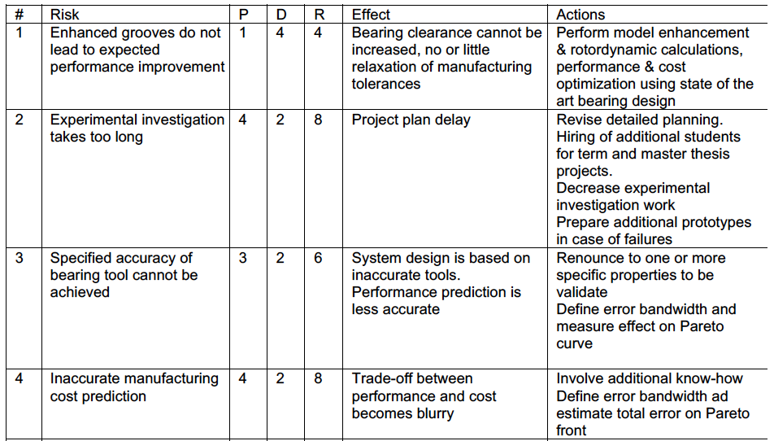
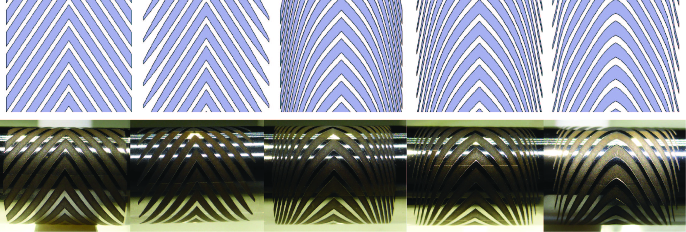
Risk Analysis
Identify potential risks and impact on project

Slide 20
Embodiment
Embodiment outcome
Customer Specification
1. Problem Definition
2. Conceptual Design
3. Embodiment
Preliminary Layout
Risk Analysis
4. Detail Design
Feasible Concept
5. Communication

Slide 21
Deliverables
Three reports
Customer Specification
1. Problem Definition
Report 1
2. Conceptual Design
Report 2
3. Embodiment
4. Detail Design
Report 3
Feasible Concept
5. Communication

Slide 22
?

